Slide 1
Computer Organization & Assembly Language
Lab 02
Representation of Numbers and Characters

Slide 2
OBJECTIVES:
• Students will come to know about different types of number systems.
• They will be able to perform conversion between number systems.
• They will learn how to perform binary and hexadecimal addition and subtraction.
• They will have a brief idea about how integers and characters are represented in computer.

Slide 3
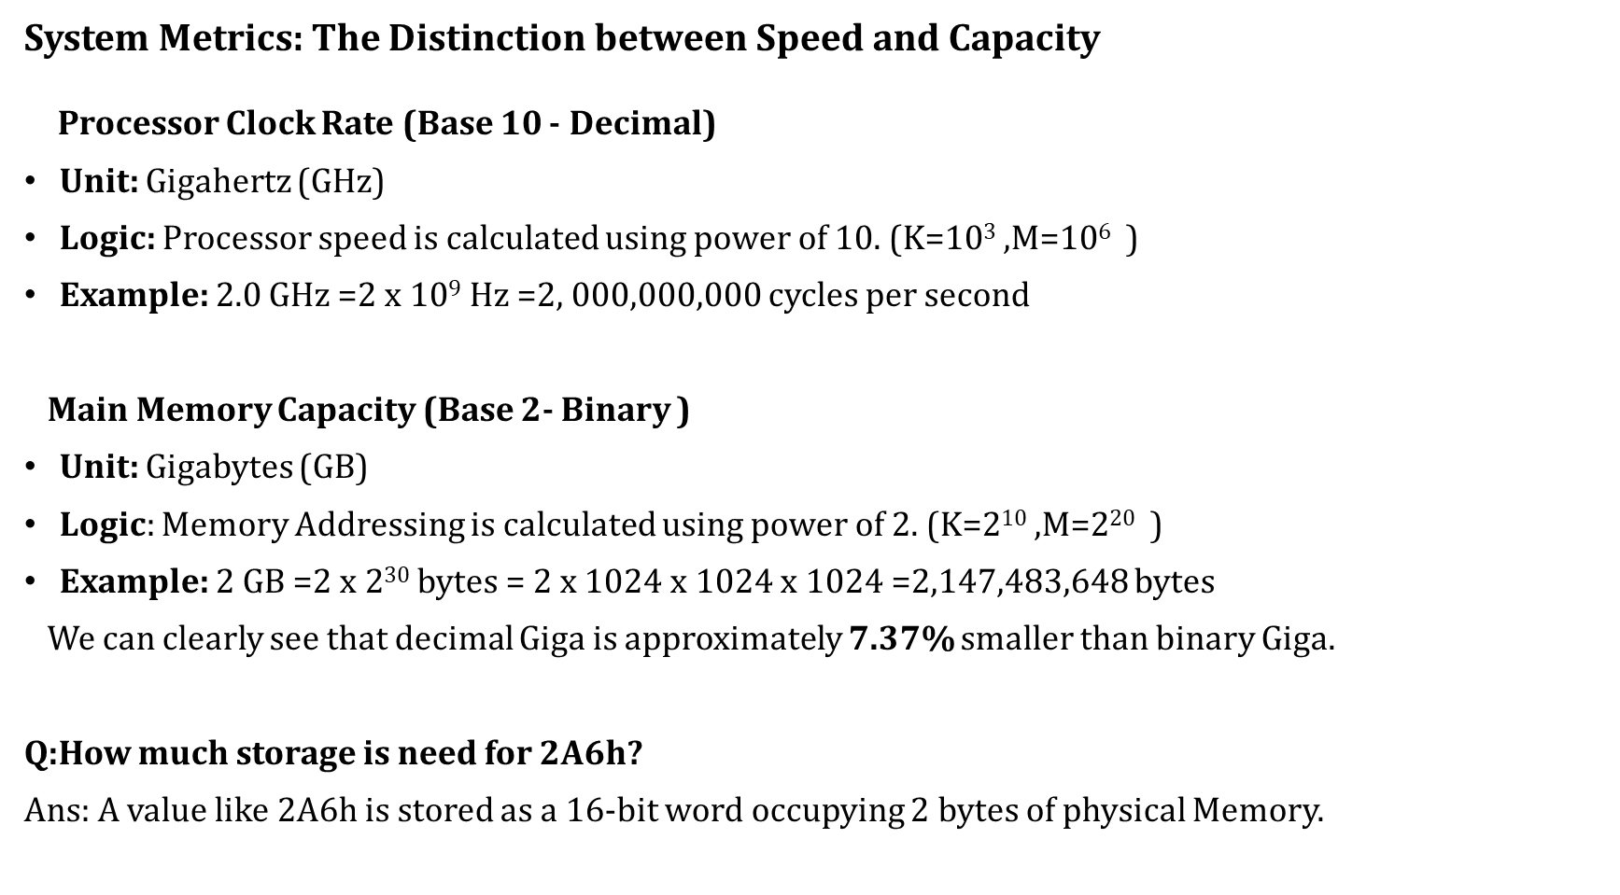
System Metrics: The Distinction between Speed and Capacity Processor Clock Rate (Base 10 - Decimal)
Unit: Gigahertz (GHz)
Logic: Processor speed is calculated using power of 10. (K=10³ ,M=10$6$ )
Example: 2.0 GHz =2 x 10⁹ Hz =2, 000,000,000 cycles per second
Main Memory Capacity (Base 2- Binary )
Unit: Gigabytes (GB)
Logic: Memory Addressing is calculated using power of 2. (K=2¹⁰ ,M=2$20$ )
Example: 2 GB =2 x 2³⁰ bytes = 2 x 1024 x 1024 x 1024 =2,147,483,648 bytes
We can clearly see that decimal Giga is approximately 7.37% smaller than binary Giga.
Q:How much storage is need for 2A6h?
Ans: A value like 2A6h is stored as a 16-bit word occupying 2 bytes of physical Memory.

Slide 4
Number Systems
In computer we use three types of number systems:
1. Decimal Number System (base10, 0-9)
2. Binary Number System (base 2, 0 and 1)
3. Hexadecimal Number System (base 16, 0-9 and A-F)
Conversion of Binary and Hex to Decimal
Hexadecimal Number, 8A2Dh = Decimal Number, 35373d
Process:
8 × 163 + A × 162 + 2 × 161 + D × 160
= 8 × 163 + 10 × 162 + 2 × 161 + 13 × 160
= 35373d

Slide 5
Conversion of Decimal to Binary and Hex
Decimal Number, 11172d = Hexadecimal Number, 2BA4h
Process:
11172=698×16+4
698=43×16+10(A) we will write from bottom to top
43=2×16+11(B)
2=0×16+2
Conversion Between Hex and Binary
Binary Number, 1110101010b = Hexadecimal number, 3AAh
0011 | 1010 | 1010
3 | A | A

Slide 6
Conversion of Fractional Decimal to Binary
The decimal number 12.25 converts to 1100.01b in binary.
The conversion is performed by splitting the number into its integer and fractional parts.
1. Integer Part: 12
To convert the integer part, divide by 2 repeatedly and record the remainders:
12 ÷ 2 = 6, Remainder 0
6 ÷ 2 = 3, Remainder 0
3 ÷ 2 = 1, Remainder 1
1 ÷ 2 = 0, Remainder 1
Reading the remainders from bottom to top gives 1100.
2. Fractional Part: 0.25
To convert the fractional part, multiply by 2 repeatedly and record the integer results:
0.25 × 2 = 0.50 (Integer part is 0)
0.50 × 2 = 1.00 (Integer part is 1)
Reading the integer parts from top to bottom gives .01.
3. Final Result
Combining both parts results in 1100.01b.

Slide 7
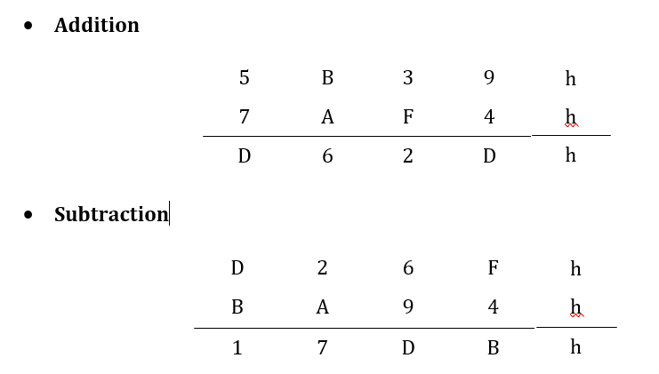
Binary and Hex Addition and Subtraction

Slide 8
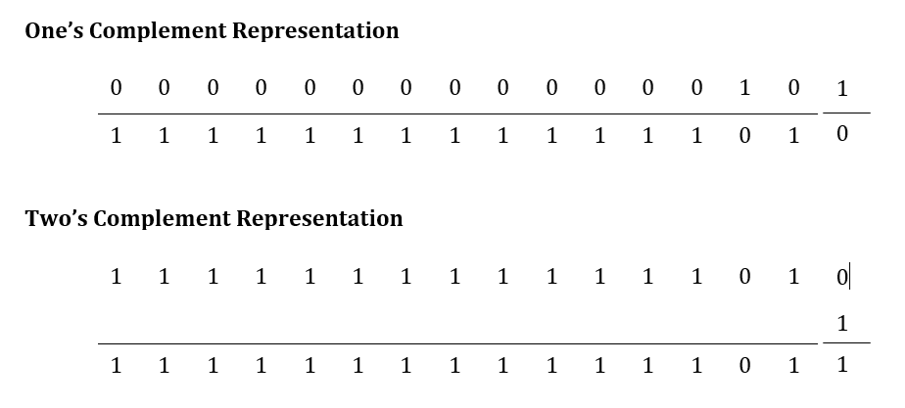

Slide 9
Integer Representations
• Unsigned Integers
Represents a magnitude so it is never negative. Largest unsigned integer stored in a byte is 11111111b = FFh =255d. Biggest unsigned integer stored in a word is
1111111111111111b = FFFFh = 65535d. If least significant bit is 0 then number is even otherwise number is odd.
Example: Addresses of memory locations, ASCII character codes.
• Signed Integers
It can either be positive or negative. Most significant bit(MSB) is reserved for sign: 0 for positive and 1 for negative. Negative integers are stored in a computer as two’s complement.

Slide 10
Decimal Interpretations
1 Unsigned Decimal Interpretation
• Binary to Decimal Conversion
2 Signed Decimal Interpretation
• If MSB is 0 then Signed Decimal is same as Unsigned Decimal
• If MSB is 1 take two’s complement and convert it to Decimal
Most significant bit of a positive signed integer is 0. So, the leading hex digit(Most Significant Nibble (MSN)) of a positive signed integer is 0-7h. Integers beginning with 8-Fh have 1 in their sign bit so they are negative.
For a word, largest positive signed integer is 7FFFh = 32767d and smallest negative signed integer is 8000h = -32768d
For a byte, largest positive signed integer is 7Fh = 127d and smallest negative signed integer is 80h = -128d
For 0000h - 7FFFh and 00h - 7Fh, signed decimal = unsigned decimal
For 8000h - FFFFh, signed decimal = unsigned decimal - 65536
For 80h - FFh, signed decimal = unsigned decimal - 256

Slide 11
Character Representation
• ASCII Code: Uses seven bits to code each character. ASCII codes from 32- 126 are considered to be printable. Others are used for communication control purposes (Non-printable) .
Example: Space key ASCII Code is 32(20h).
• Scan Code: Each key on an IBM-PC keyboard is assigned a unique hardware-dependent code known as scan code. When a key is pressed or released, the keyboard controller sends this code to the system, which then translates it into the corresponding ASCII character or control action.
Example: keys like Ctrl, Shift, Alt have scan codes only, they don't produce ASCII codes by themselves.

